Slide 1
cloud.js
Andre Rodrigues
Software Development Engineer
Email: andrerod@microsoft.com
Twitter: @andremrodrigues

Slide 2
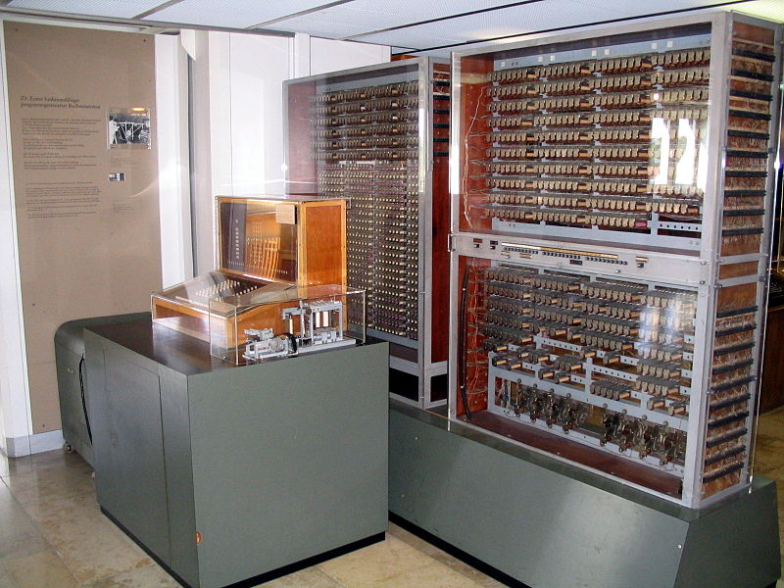
1941 - Zuse Z3
Notes:
Invented in 1941 is considered by many as being the first working programmable, fully working automatic computing machine.

Slide 3
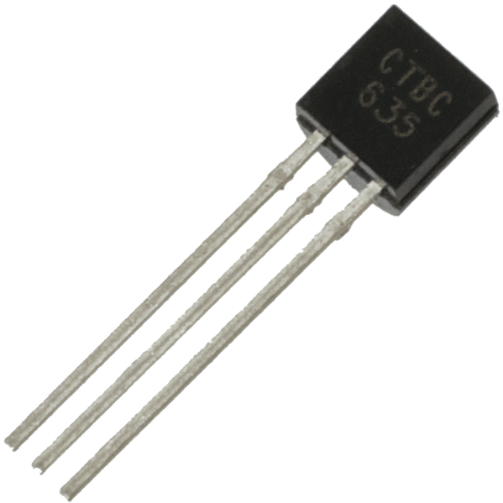
1947 – The transistor

Slide 4
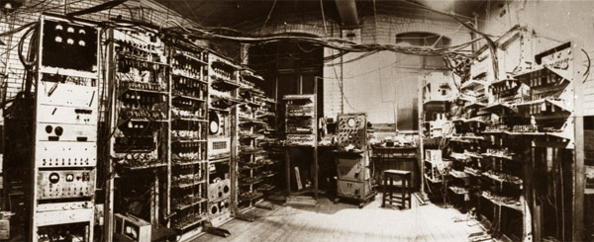
1953 / 1955 – First transistor based computer
Notes:
The 1953 – prototype - machien had 92 point-contact transistors and 550 diodes manufactored by STC.
The 1955 – experimental - had 200 point-contact transistors.

Slide 5
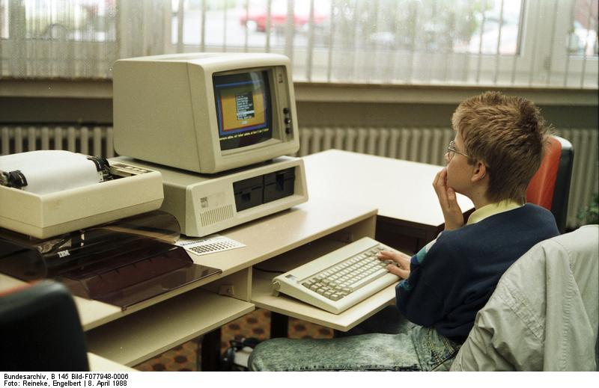
1988 - IBM personal computer
Notes:
The IBM personal computer, launched in 1988 was a key step in the direction of the personal computer vision

Slide 6
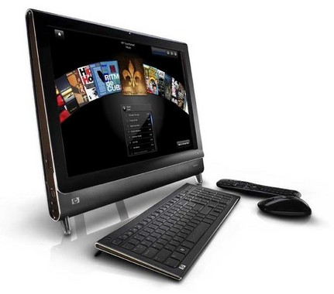
Modern computer

Slide 7
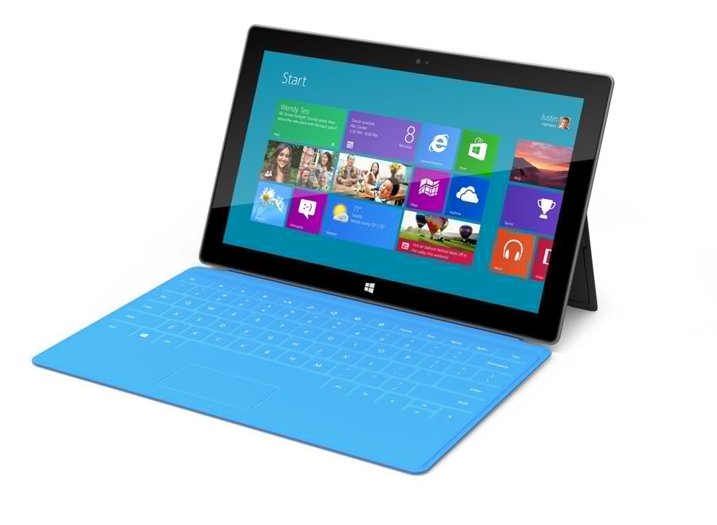
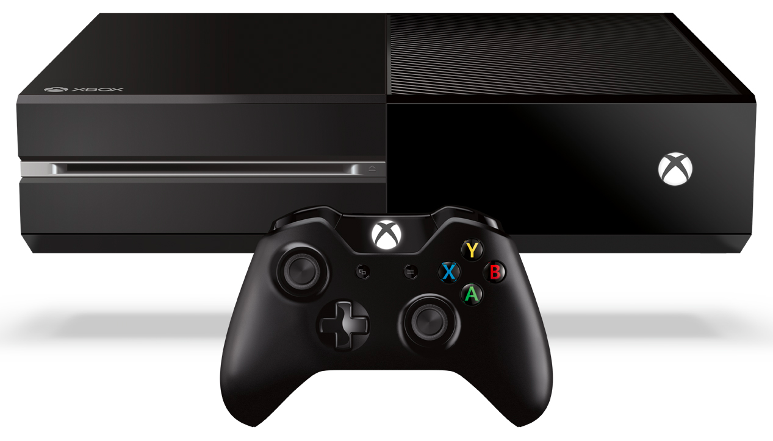
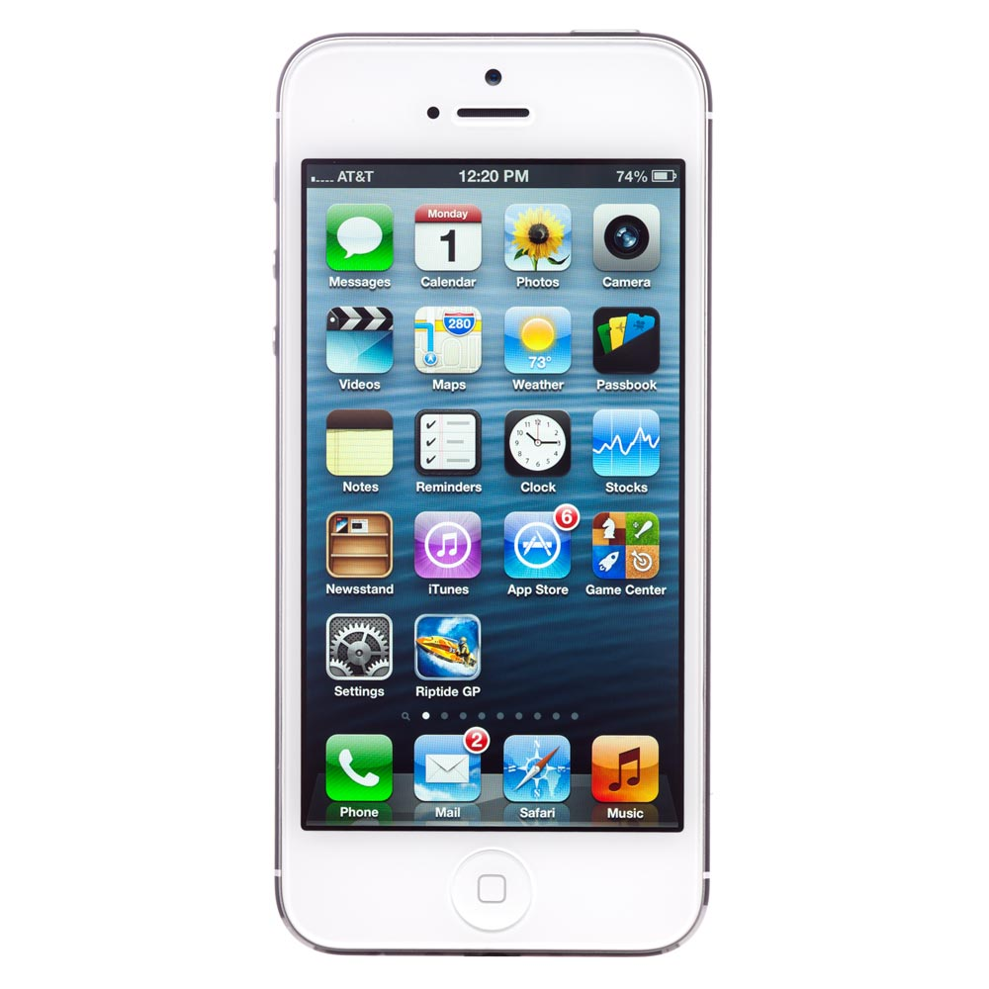
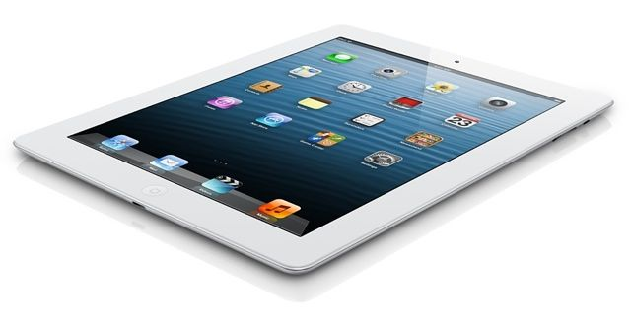
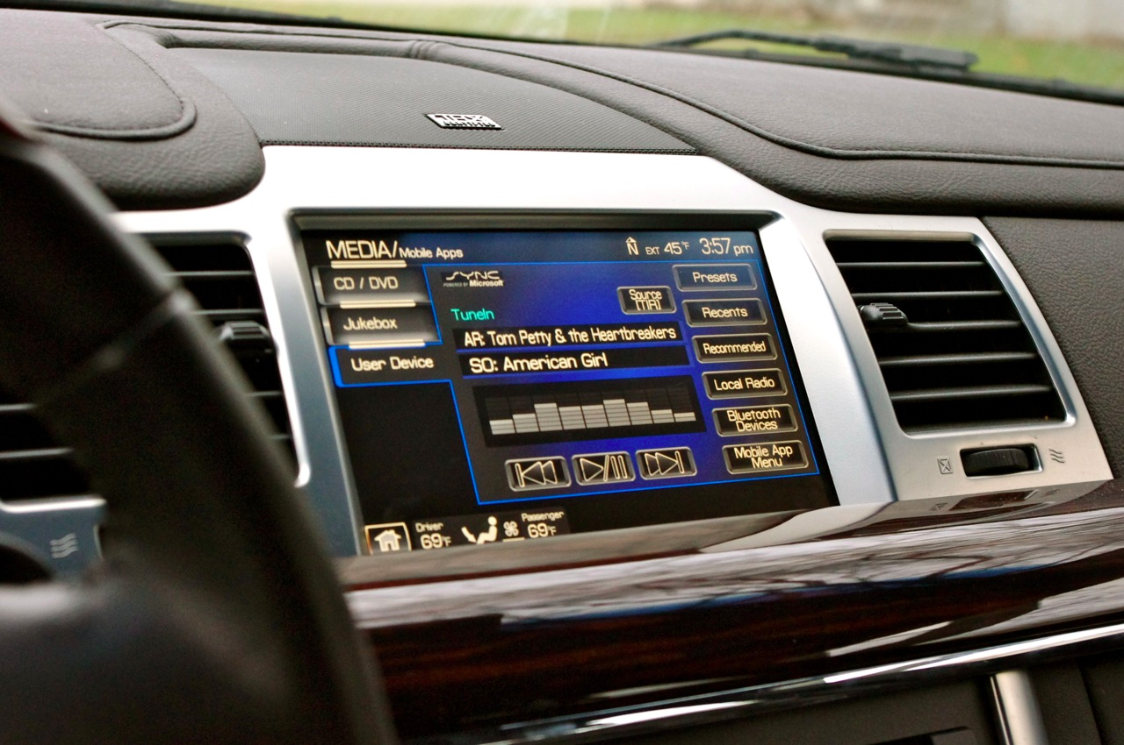
Modern devices

Slide 8
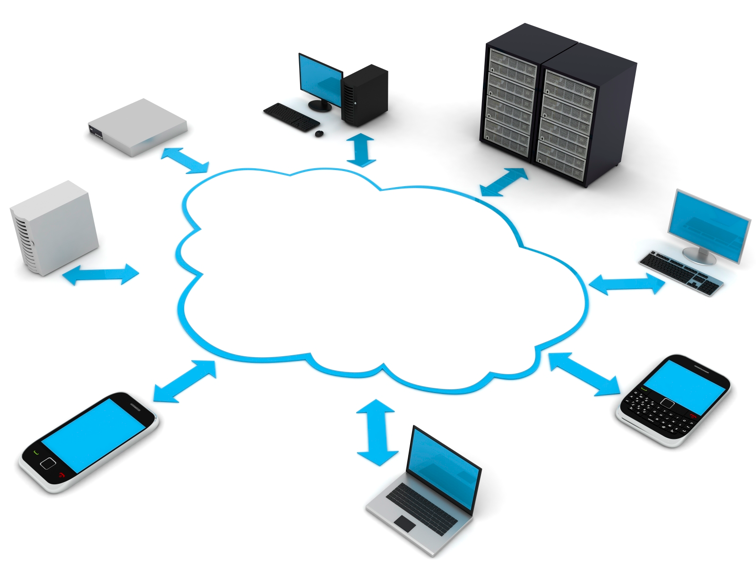
Cloud Computing
Notes:
New ways of interacting with the apps we develop today – mobile / Web 2.0 / etc

Slide 9
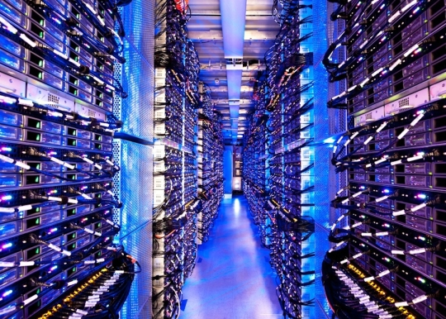
Cloud computing

Slide 10

Growing user base
Spikes in demands
Potential Entrants
Suppliers
Industry Rivalry
Buyers
Substitutes
Time to market
Notes:
Eventually, you get more users, and with those, the need to process their multiple requests

Slide 11
That’s cool and all, but…
Show us how it works

Slide 12
www.windowsazure.cn

